Slide 1
Constraint Satisfaction Problems
Lecture 6

Slide 2
Outline
CSP examples
CSP description
CSP as a backtracking search problem
Improving the efficiency of the backtracking
Problem Decomposition

Slide 3
Constraint satisfaction problems (CSPs)
Standard State-space Problem:
state is a “black box”—any data structure that supports goal test, evaluation, and successor function must be specified
Constraint Satisfaction Problem:
state is defined by variables X_{i} with values from domain D_{i}
successor function assigns values to the variables
goal test is a set of constraints specifying allowable combinations of values
constraints can be static or can be evaluated dynamically through propagation
Examples of data structures to use for the states:
Arrays (index numerically ordered)
Attribute/value pairs (key alphabetically ordered)
Hash Tables (key hashed)
Trees (node linked using references, acyclic)
Graphs (node linked using references, possible cycles), etc.
Allows to use general-purpose algorithms with more power than the standard search algorithms

Slide 4
Example: Map-Coloring
Northern Territory
Western Australia
Queensland
South Australia
New South Wales
Victoria
Variables: WA, NT , Q, NSW , V , SA, T
Domains: D_{i} = {red, green, blue}
Tasmania
Constraints: adjacent regions must have different colors e.g.,
WA ≠ NT (if the language allows this), or
(W A, NT ) ∈ {(red, green), (red, blue), (green, red) . . .}

Slide 5
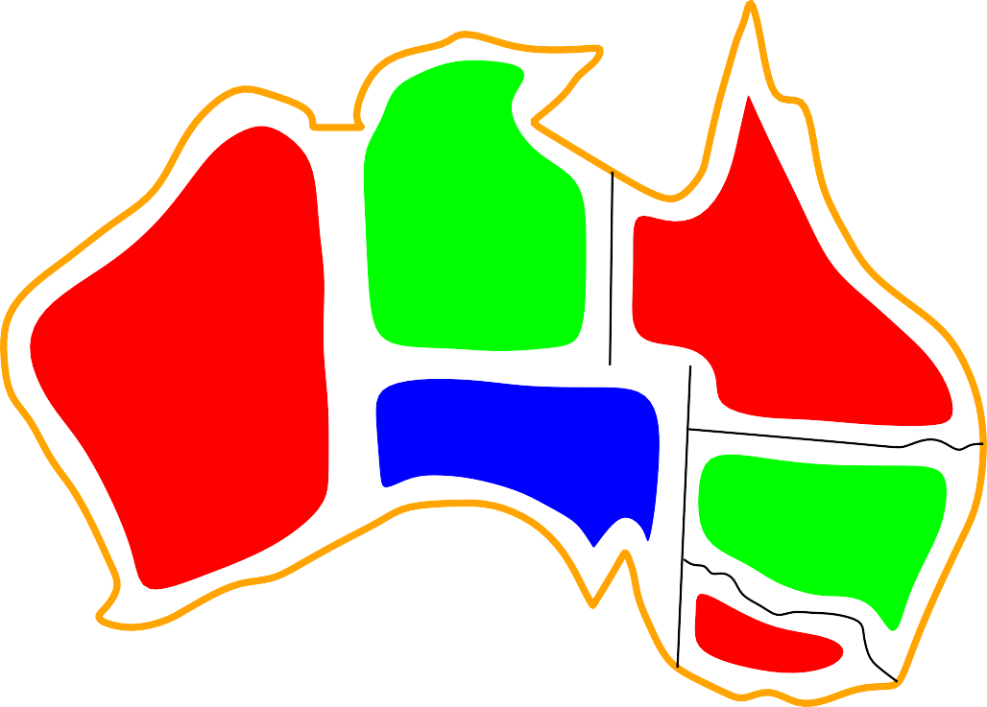

Example: Map-Coloring contd.
Northern Territory
Western Australia
Queensland
South Australia
New South Wales
Victoria Tasmania
Solution of the problem is the sequence of assignments satisfying all constraints, e.g.,
{WA = red, NT = green, Q = red, NSW = green, V = red, SA = blue, T = green}

Slide 6
Relating the constraints in a CSP graph
Constraint graph: nodes are variables, arcs show constraints
NT
Q
WA
NSW
SA
V
T
Binary CSP: each constraint relates at most two variables
General-purpose CSP algorithms use the graph structure to speed up search.
Tasmania is an independent subproblem!

Slide 7
Varieties of CSPs
Discrete variables
finite domains: n variables with domain of d values have O(d^{n}) possible assignments
e.g., Boolean CSPs, incl. Boolean satisfiability
⇒ NP-complete
infinite domains (integers, strings, etc.)
e.g., in job scheduling, variables are start/end days for each job
need a constraint language, e.g., StartJob₁ + 5 ≤ StartJob₃
⇒ linear constraints solvable, nonlinear undecidable
Continuous variables
continuous domains of measurements (distances, locations, times, etc.)
e.g., start/end times for Hubble Telescope observations
⇒ linear constraints solvable in poly time by linear programming methods

Slide 8
Varieties of constraints
Unary constraints involve a single variable, e.g., SA ≠ green
Binary constraints involve pairs of variables, e.g., SA ≠WA
Higher-order constraints involve 3 or more variables, e.g., cryptarithmetic constraints binding the values of a column in an encryption row
Preferences (soft constraints), e.g., red is better than green: often representable by a cost for each variable assignment
⇒ lead to constrained optimization problems

Slide 9
Real-world CSPs
Most real-world problems can be formulated as CSP
Task allocation
e.g., who teaches what class
Timetabling and resourcing
e.g., which class is offered when and where?
Hardware configuration
e.g., which component to use where
Transportation scheduling
e.g., which city to visit first, which next, then next …
Factory scheduling
e.g., which operation to do first, which next, then next, etc.
Many of the real-world problems involve real-valued variables (people, places, money, etc.)

Slide 10
Standard search formulation (incremental)
Let’s start with the straightforward, dumb approach (British Museum algorithm)
States are defined by the values assigned so far
Initial state: the empty assignment, { }
Successor function: assign a value to an unassigned variable that does not conflict with the current assignment.
⇒ fail if there are no legal assignments (not fixable – error in the spec or no solution!)
Goal test: the current assignment is complete
Properties of the algorithm for n – variables, d –values, l-depth, b-branches)
This is the same for all CSPs!
Every solution at depth l appears as n-l assignments for the variables from d
⇒ use depth-first search
Path is irrelevant, so can also use complete-state formulation
b = (n − l)d at depth level l, hence n! d^{n} leaves!!!!

Slide 11
Backtracking search formulation (recursive)
Based on the observation that the value assignments are symmetric, i.e. [if WA=red then NT =green] is the same as [if NT =green then WA=red]
we consider assignments to a single variable at each node, thus fixing the breadth of the tree b = d and having d^{n} leaves
we allow trying alternative assignments for each variable previously assigned in the case we cannot do it
Depth-first search for CSPs with single-variable assignments is called backtracking search; it is the basic uninformed algorithm for CSPs
Can solve to n-queens problem for up to n ≈ 25

Slide 12
Backtracking search
function Backtracking-Search(csp) returns solution/failure
return Recursive-Backtracking({ }, csp)
function Recursive-Backtracking(assignment, csp) returns soln/failure
if assignment is complete then return assignment
var ← Select-Unassigned-Variable(Variables[csp], assignment, csp)
for each value in Order-Domain-Values(var, assignment, csp) do
if value is consistent with assignment given Constraints[csp] then
add {var = value} to assignment
result ← Recursive-Backtracking(assignment, csp)
if result /= failure then return result
remove {var = value} from assignment
return failure

Slide 13
Backtracking example

Slide 14
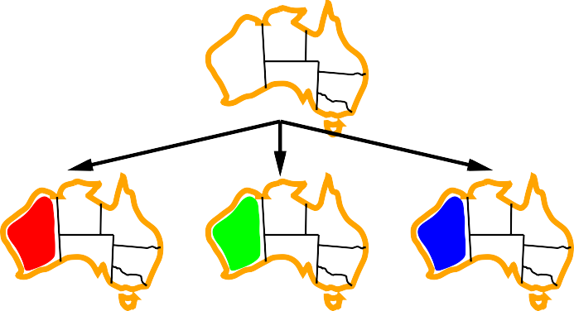
Backtracking example

Slide 15


Backtracking example

Slide 16

Backtracking example

Slide 17
Improving backtracking efficiency
General-purpose methods can give huge gains in speed if the choices of alternatives at a node are informed:
Which variable should be assigned next?
In what order should its values be tried?
Can we detect inevitable failures early?
Can we take advantage of problem structure?

Slide 18
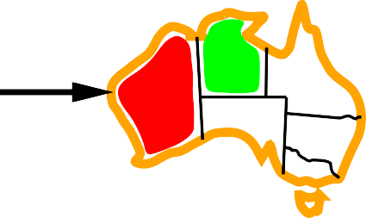
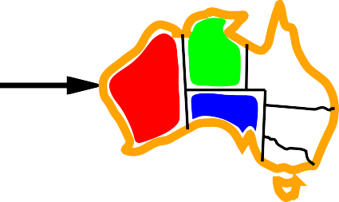


Minimum remaining values
Minimum remaining values (MRV)
Heuristic: choose the variable with the fewest legal values
⇒ Increases the speed of moving forward along the way because of systematic limiting of the choices

Slide 19
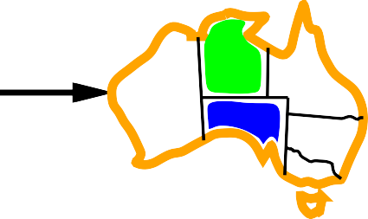
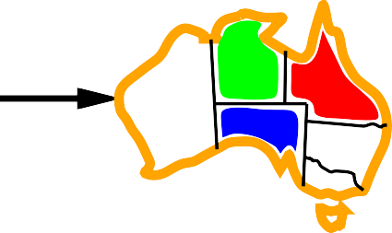

Degree heuristic
Tie-breaker among MRV variables
Heuristic: choose the variable with the most constraints on the remaining variables
⇒ Reduces the complexity of the original task by splitting it into two subtasks with much smaller complexity; if the first subtask is solved, the rest are easier

Slide 20
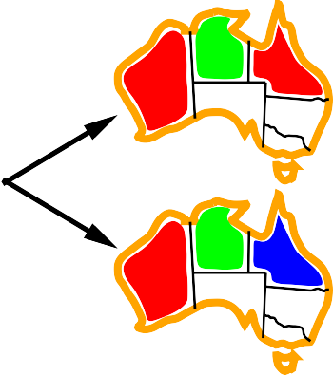
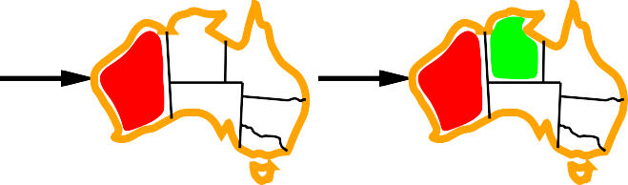
Least constraining value
Least Constraining Value
Heuristic: Given a variable, try to assign the least constraining value, i.e. the one that rules out the fewest values in the remaining variables
Allows 1 value for SA
Allows 0 values for SA
Combining these heuristics makes 1000 queens problem feasible

Slide 21
Forward checking
Idea: Keep track of remaining legal values for unassigned variables and terminate the search when any variable has no legal values
Northern Territory
Western Australia
Queensland
South Australia
New South Wales
Victoria
Tasmania
WA
NT
Q
NSW
V
SA
T

Slide 22


Forward checking
Idea: Keep track of remaining legal values for unassigned variables Terminate search when any variable has no legal values
WA
NT
Q
NSW
V
SA
T

Slide 23
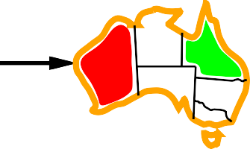


Forward checking
WA
NT
Q
NSW
V
SA
T

Slide 24
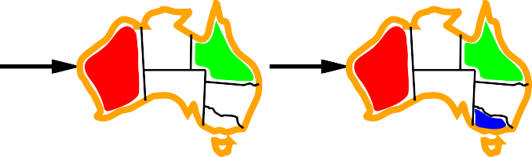


Forward checking
WA
NT
Q
NSW
V
SA
T

Slide 25
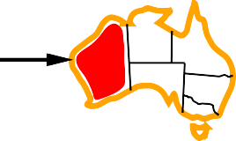

How to propagate constraints?
Problem: Forward checking propagates information from assigned to unassigned variables, but doesn’t provide early detection for all possible late failures:
WA
NT
Q
NSW
V
SA
T
⇒ NT and SA cannot both be blue, so the previous choice must be abandoned!
Constraint propagation at each node starts with the initial constraints produced after the last forward checking
Constraint propagation repeatedly enforces constraints locally on each node and then moves forward, if possible; otherwise, it goes back

Slide 26


Preserving arc consistency
Simplest form of propagation makes each arc consistent
X → Y is consistent IF for every value x in X there is some allowed y in Y
WA
NT
Q
NSW
V
SA
T

Slide 27
Preserving arc consistency
WA
NT
Q
NSW
V
SA
T

Slide 28
Preserving arc consistency
WA
NT
Q
NSW
V
SA
T
If X loses a value, neighbors of X need to be rechecked

Slide 29
Preserving arc consistency
WA
NT
Q
NSW
V
SA
T
If X loses a value, neighbors of X need to be rechecked
! Arc consistency detects failure earlier than forward checking Can be run as a preprocessor or after each assignment

Slide 30
Arc consistency algorithm
function AC-3( csp) returns the CSP, possibly with reduced domains
inputs: csp, a binary CSP with variables {X₁, X₂, . . . , X_{n}}
local variables: queue, a queue of arcs, initially all the arcs in csp
while queue is not empty do
(X_{i}, X_{j} ) ← Remove-First(queue)
if Remove-Inconsistent-Values(X_{i}, X_{j} ) then for each X_{k} in Neighbors[X_{i}] do
add (X_{k}, X_{i}) to queue
function Remove-Inconsistent-Values( X_{i}, X_{j}) returns true iff succeeds
removed ← false
for each x in Domain[X_{i}] do
if no value y in Domain[X_{j}] allows (x,y) to satisfy the constraint X_{i} ↔ X_{j}
then delete x from Domain[X_{i}]; removed ← true
return removed
O(n²d³), can be reduced to O(n²d²) (but detecting all consistencies is NP-hard)

Slide 31
Problem structure
NT
Q
WA
SA
NSW
V
T
Tasmania and mainland are independent subproblems
Identifiable as connected components of the constraint graph

Slide 32
Problem structure contd.
Suppose each subproblem has c variables out of n total variables of the original problem where d is the domain of possible values assigned to c
Worst-case solution cost for each of the subproblems is n/c x d^{c}, which is linear in n but exponential in c
Example: for n = 80, d = 2, c = 20 (factorization of binary problem)
2⁸⁰ = 4 billion years at 10 million nodes/sec (original
4 ·x 2²⁰ = 0.4 seconds at 10 million nodes/sec

Slide 33
Tree-structured CSPs
A E
B D
C F
Theorem: if the constraint graph has no loops, the CSP can be solved in
O(n d²) time
⇒ Compare to general CSPs, where worst-case time is O(d^{n})
Each propagation can go forward or backward only, not in all possible directions which reduces the returns drastically

Slide 34
Algorithm for tree-structured CSPs
1. Choose a variable as root, order variables from root to leaves such that every node’s parent precedes it in the ordering
A E
B D A B C D E F F
C
For j from n down to 2, apply RemoveInconsistent(Parent(X_{j}), X_{j})
For j from 1 to n, assign X_{j} consistently with Parent(X_{j})

Slide 35
Nearly tree-structured CSPs
Conditioning: instantiate a variable, prune its neighbors’ domains
NT
NT
Q
Q
WA
WA
SA
NSW
NSW
V
V
T
T
Cutset conditioning: instantiate (in all ways) a set of variables such that the remaining constraint graph is a tree
Cutset size c ⇒ runtime O(d^{c} · (n − c)d²), very fast for small c (remembering less, cutting more)

Slide 36
Iterative algorithms for CSPs
Hill-climbing, simulated annealing typically work with “complete” states, i.e., all variables are assigned;
To apply them to CSPs, we must allow states with unsatisfied constraints operators to reassign variable values
Different choice of variables for reassignment
Random selection of any conflicted variable for reassignment
Selection by min-conflicts heuristic: choose value that violates the fewest constraints to minimize potential conflicts as a result of the reassignement Example: hillclimb with min h(n) = total number of violated constraints

Slide 37

Example: 4-Queens
States: 4 queens in 4 columns (4⁴ = 256 states)
Operators: move queen in column Goal test: no attacks
Evaluation: h(n) = number of attacks
h = 5
h = 2
h = 0

Slide 38
Performance of min-conflicts
Given random initial state, can solve n-queens in almost constant time for arbitrary n with high probability (e.g., n = 10,000,000)
The same appears to be true for any randomly-generated CSP except in a narrow range of the ratio
number of constraints
R =
number of variables
CPU
time
R
critical ratio

Slide 39
Summary
CSPs are a special kind of problem:
states defined by values of a fixed set of variables
goal test defined by constraints on variable values
Backtracking = depth-first search with one variable assigned per node
Variable ordering and value selection heuristics help significantly
Forward checking prevents assignments that guarantee later failure
Constraint propagation (e.g., arc consistency) does additional work
to constrain values and detect future inconsistencies
The CSP representation allows analysis of problem structure
Tree-structured CSPs can be solved in linear time
Iterative min-conflicts is usually effective in practice

